Slide 1


Corporate Presentation
February 2023

Slide 2
Disclaimer
This Presentation has been prepared by Proeduca Altus, S.A. (together with its subsidiaries and investees worldwide, except as the context otherwise requires, the “Company”). For the purposes of this disclaimer, “Presentation” means this document, its contents or any part of it, any oral presentation, any question and answer session and any written or oral material discussed or distributed during any meeting to discuss this Presentation or otherwise in connection with it.
This Presentation does not constitute, and may not be relied on in any manner as, legal, tax, investment, accounting, regulatory or any other type of advice on, about or in relation with the Company, nor does it constitute or form part of, and should not be construed as, any offer to sell or issue or invitation to purchase or subscribe for, or any solicitation of any offer to purchase or subscribe for, or otherwise acquire, any securities of the Company, nor shall it or any part of it —nor the fact of its distribution— form the basis of, or be relied upon in connection with, any contract or investment decision.
This Presentation is provided to the recipients for general informational purposes only. The information provided herein is not to be relied upon in substitution of the recipient exercising its own independent judgment with regard to the operations, financial condition and prospects of the Company. None of the statements herein shall be understood as intending to create any contractual obligation between its recipient and the Company, neither on their own behalf nor that of any third party.
The information contained in this Presentation does not purport to be comprehensive and has not been independently verified. Neither the Company nor its directors, officers, employees advisers or agents, accepts any responsibility or liability whatsoever for, or makes any representation or warranty, express or implied, as to, and no reliance should be placed on, the truthfulness, fullness, accuracy or completeness of the information contained or referred to in this Presentation (or whether any information has been omitted from this Presentation) or any other information relating to the Company, whether written, oral or in a visual or electronic form, and howsoever transmitted or made available, and nor do they accept any responsibility or liability whatsoever for any loss howsoever arising from any use of this Presentation or its contents or otherwise arising in connection therewith. Each of such persons accordingly disclaims any and all liability whatsoever, whether direct or indirect, express or implied, arising in tort, contract or otherwise, in respect of this Presentation or any such information.
The information and forward-looking statements contained in this Presentation have not been verified by an independent entity and the accuracy, completeness or correctness thereof should not be relied upon. In this regard, the persons to whom this Presentation is delivered are invited to refer to the documentation filed by the Company with BME Growth. All forecasts and other statements included in this Presentation that are not statements of historical fact, including, without limitation, those regarding the financial position, business strategy, management plans, targets, outlook, guidance and objectives for future operations and run rate metrics of the Company, are forward-looking statements. These forward-looking statements involve known and unknown risks, uncertainties and other factors (many of which are beyond the Company’s control), which may cause actual results, performance or achievements of the Company, or industry results, to be materially different from those expressed or implied by these forward-looking statements. These forward-looking statements are based on numerous assumptions regarding the Company‘s present and future business strategies, performance by the Company’s counterparties under certain of the Company’s contracts and the environment in which the Company expects to operate in the future which may not be fulfilled. No representation or warrant, express or implied is made that any forward-looking statement will come to pass. In particular, this Presentation contains information on the Company’s targets, outlook and guidance, which should not be construed as profit forecasts. There can be no assurance that these targets, outlook and guidance will be met. Accordingly, undue reliance should not be placed on any forward-looking statement contained in this Presentation. All forward-looking statements and other statements herein are only as of the date of this Presentation. None of the Company, , nor any of its affiliates, advisors or representatives, nor any of their respective directors, officers, employees or agents, undertake any obligation to provide the recipients with access to additional information or to update this Presentation or to correct any inaccuracies in the information contained or referred to herein.
Neither this Presentation nor the historical performance of the Company's management team constitute a guarantee of the future performance of the Company and there can be no assurance that the Company's management team will be successful in implementing the business strategy of the Company going forward.
To the extent available, the industry and market data contained in this Presentation has come from official or third party sources. Third party industry publications, studies and surveys generally state that the data contained therein have been obtained from sources believed to be reliable, but that there is no guarantee of the accuracy or completeness of such data. In addition, certain of the industry and market data contained in this Presentation come from the Company’s own internal research and estimates based on the knowledge and experience of the Company’s management in the market in which the Company operates, and is subject to change. Certain information contained herein is based on the Company’s management information and estimates and has not been audited or reviewed by the Company’s auditors. Recipients should not place undue reliance on this information. The financial information included herein has not been reviewed by the Company’s auditors for accuracy or completeness and, as such, should not be relied upon. Certain financial and statistical information contained in this Presentation is subject to rounding adjustments. Accordingly, any discrepancies between the totals and the sums of the amounts listed are due to rounding.
This Presentation contains certain non-IFRS financial measures of the Company derived from (or based on) its accounting records, and which it regards as alternative performance measures (APMs) for the purposes of Commission Delegated Regulation (EU) 2019/979 of March 14, 2019 and as defined in the European Securities and Market Authority Guidelines on Alternative Performance Measures dated October 5, 2015. You may find a definition of the alternative performance measures used herein and its reconciliation with the historical financial information of the Company in the filings of the Company with BME Growth. Other companies may calculate such financial information differently or may use such measures for different purposes than the Company does, limiting the usefulness of such measures as comparative measures. These measures should not be considered as alternatives to measures derived in accordance with IFRS, have limited use as analytical tools, should not be considered in isolation and, may not be indicative of the Company’s results of operations. Recipients should not place undue reliance on this information.
The distribution of this Presentation in certain jurisdictions may be restricted by law. Consequently, persons to which this Presentation is distributed must inform themselves about and observe such restrictions. By receiving this Presentation the recipient agrees to observe any such restrictions.

Slide 3

















PROEDUCA at a glance
Business overview
Global presence
  One of the leading international providers of online education based in Spain offering university online courses in Spain, Latin America (Colombia, Ecuador, Mexico and Peru) and the United States
  Founded in 2007, Proeduca is a pioneer in developing a fully-online, effective and student-centred education model that adapts to the needs of the student
  Serves over 84,000 students from more than 90 countries and offers more than 370 bachelors’ and masters’ degrees, PhDs and courses
  University accredited in the EU, Colombia, Ecuador, Mexico, Peru, Guatemala and the United States
  Management team with extensive experience in diverse fields (education, marketing, retail, etc.), organized in an efficient structure through differentiated corporate and academic departments
  Proeduca is listed on the BME Growth segment¹ in Spain since 2019
Country
University / Academy
Ownership
España
³
99,4%
España
100%
España
100%
España
100%
México
100%
EEUU
100%
Perú
100%
Colombia
(Under management)
Guatemala
(Under management)
Financial evolution (€mm)
Shareholder structure (31/12/2022)
²
Adj. EBITDA margin² (%)
CAGR 2016–22A
25.1%
31.1%
16.7%
14.8%
21.4%
21.1%
21.2%
21.4%
22.4%
Note: Fiscal year-end is August (in line with the academic year)
¹ BME Growth is a segment of BME MTF Equity
² Adj. EBITDA defined as net income + income tax + financial results + D&A + income and expense considered not recurring
³ UNIR also serves the Ecuadorian market
⁴ Miguel Tomás Arrufat Pujol, founder and CEO of Proeduca Altus

Slide 4


History & Development of Proeduca
Since inception, Proeduca has achieved important milestones positioning itself as one of the leading online universities in Spanish language
2007
Miguel Tomás Arrufat Pujol along with other professionals with experience in higher education founded UNIR
2012
Incorporation of UNIR Mexico after being accredited by the Mexican Secretary of
Public Education (“SEP”)
2016
Acquisition of CUNIMAD
2017
Opening of local offices
in Ecuador
Incorporation of the UNIR Foundation Colombia
2018–19
Acquisition of MIU City
University Miami
2019–20
EDIX launch
2022
Decroly acquisition
Foundation
Internationalization
2007
2008
2009
2010
2011
2012
2013
2014
2015
2016
2017
2018
2019
2020
2021
2022
2009-2010
UNIR starts the activity
in Spain
2015
Opening of local offices in Colombia
2016
Opening of local offices in Peru
2019
PROEDUCA is listed on the BME Growth segment ¹
Acquisition of 80% of
Newman Business School
2021
Acquisition of KSchool
Incorporation of Uni. InterNaciones
€250m
Revenue CAGR: 30%
PROEDUCA is a success story of international roll-out of an online-education business
€24m
Year 2013
Bacherlors' and masters' degrees, PhDs and courses
Year 2022
70
333²
12.7k
Number of students
84.8k
¹ BME Growth is a segment of BME MTF Equity
² Does not include titles of UNIR Colombia, and InterNaciones University (as they are centers under management)

Slide 5



An extensive and international academic offering
Proeduca manages nine academic institutions which offer more than 370 degrees; including bachelors’ degrees, masters, PhDs and other courses
Universidad Internacional de La Rioja (UNIR Spain)
Education
Business and
communication
Law
Social
Sciences
Engineering
/Technology
Sciences of
health
14 Degrees
21 Masters
1 PhD
8 Own Titles¹
6 Degrees
24 Masters
12 Own Titles¹
3 Degrees
20 Masters
5 Own Titles¹
14 Degrees
15 Masters
9 Own Titles¹
7 degrees
24 Masters
1 PhD
11 Own Titles¹
1 Degree
12 Masters
20 Own Titles¹
UNIR's Spanish degrees are also offered to students in LatAm with the support of a local office in charge of administrative tasks
Complementary academic offering
Proeduca aims to replicate its model with UNIR Spain, adapting it to each country
5 Official titles:
3 Degrees
2 Masters
51 National titles:
8 Bachelor’s degrees
43 Master’s degrees
10 National titles:
10 Master’s degrees
4 Official titles:
2 Degrees
2 Masters
1 Own Titles¹
14 Official titles:
8 Bachelor’s degrees
6 Masters
1 Own Titles¹
24 Official titles:
11 Bachelor’s degrees
13 Maestrías
7 Own titles¹
2 “Formación Profesional” Titles
27 Own titles¹
¹ Own titles are not official degrees, therefore the structure and content of each title is designed by Proeduca’s relevant subsidiary

Slide 6
PROEDUCA: A unique proposition in the attractive online learning sector
1
Well positioned in a large, high-growing market with strong underlying drivers
2
Leading online university with presence across Spanish speaking
countries in the Americas and Europe
3
Rich academic offer and strong brand which serves a fast-growing and well diversified student base
4
Differentiated education model which drives high retention and graduation rates
5
Attractive financial profile characterized by significant student growth and a scalable model
6
Experienced founder-led management team

Slide 7
Well positioned in a large, high-growing market with strong underlying drivers…
1
High-growing incipient market with favorable trends…
Online 3.1% of the world's education is on an online basis
Online-education is expected to grow by c.2x in the following decade
Market value of global education and online education, 2019-30 (US$bn)
Online education market
Global education market
1.6x
3.1%
?
… enhanced by a change in the paradigm of education…
The higher education market has grown significantly in the recent years
Broader student base, particularly in LatAm
% Population enrolled in higher education¹ in LatAm²
+21.6% increase
… and with relevant presence in the education market
From 2005 to 2019, the number of online university students has increased at an average CAGR of +8.3% in Spain
Online students represent c.6% of all the university students in Spain
Online university students in Spain, 2005-19 (#k, %)
CAGR 2005-2019A: +8.3%
~6%
Total university
students in
Spain
Source: Holoniq, UNESCO, Eurostat; MEFP, World Development Indicators
¹ Higher education includes university degrees, masters, PhD or any postgraduate title
² LatAm countries included are: Argentina, Bolivia, Brazil, Chile, Colombia, Costa Rica, Cuba, Dominican Republic, Ecuador, Guatemala, Honduras, Jamaica, México, Nicaragua, Panamá, Perú, Puerto Rico, El Salvador, Uruguay y Venezuela

Slide 8



… with special growth potential in LatAm countries
1
PROEDUCA enjoys a privileged positioning in the LatAm region
Key highlights
Participation rate in higher education between 25-34 years old, 2017 (%)
A growing percentage of the population enrolls in higher education
Ample room for growth in LatAm, which has lower enrollment rates than in the United States and Europe
Strengthening UNIR’s position in LatAm which accounts almost 40%
of its student base
55%
North America
Europe
43%
49%
UNIR’s student base by geography¹
Asia
6%
Africa
Oceania
LatAm
48%
24%
Well stablished institutions in LatAm and the United States
Source: Eurostat
¹ As of 2022
² Rest of the world

Slide 9

























Leading online university with presence across Spanish speaking countries in the Americas and Europe
2
Growing and sizeable student base
Main characteristics
Main players
Spain
Spanish universities are traditionally on-site and make up most of the competitive environment
Traditional universities are starting to offer online-education
Online universities focus their resources on academics, technology, user experience and R&D
1.6 million students
+1.6%
Mexico
The main online universities in Mexico are private or do not offer 100% online-education
Laureate International University is strongly positioned
4.1 million students
+4.7%
Colombia
Main competitors are foreign education institutions
Strong presence of Spanish institutions (UOC, VIU...)¹
Colombian universities are considered indirect competition
2.4 million students
0.0%
Ecuador
Ecuadorian universities have limited online offer
UNIR is well placed to offer online-education
Sizeable number of Ecuadorian students
0.6 million students
+1.4%
Peru
Peruvian universities are starting to offer online-education
National universities are considered indirect competition
Direct competition comes from foreign players with strong student base (i.e. Spain)
0.9 million students
+2.8%
US
US universities are traditionally on-site and non-profit or state-run but there is increasing demand for online learning
Regulatory changes and high costs have adversely impacted enrollment trends historically, especially at for-profit universities
Traditional universities are beginning to offer online-education
19.7 million students
+0.3%
Source: Eutostat, Statista, Red Indic, Higher Education Students
¹ UOC: Universitat Oberta de Catalunya; VIU: Valencian International University
PROEDUCA university
CAGR

Slide 10


Rich academic offer and strong brand which serves a fast-growing and well diversified student base
3
Strong brand reach and recognition…
…covering a wide range of disciplines…
…results in a fast-growing and well-diversified student base
Number of enrolled students (#)
Engineering/
Technology
Offer breakdown¹
18%
University
degrees
CAGR 2013-22A: +23.5%
Sciences & Health
2022A
52%
Post graduate programs
Education
Students’ breakdown
By gender
By origin
Law & Humanities
30%
Own degree programs
85k
2022A
85k
2022A
4/5 satisfaction index
70k+ Graduated students since inception
Business and Communication
Source: Company information
¹ By number of programs offered excluding titles offered by InterNaciones and Fundación Colombia

Slide 11


Superior online educational system that provides highest quality and student experience
4
Unique education and operational model
Live classes
Technology at the service of education
Live classes allow ongoing interaction between students and professors. Proeduca's platform allows video, audio and projection on real time. Classes are recorded and accessible at any time
Proeduca's tech capabilities offer a 100% online learning experience that allows an efficient education system with direct interaction
8
1
Zero Gap: content adapted to the latest trends
Constant support from personal tutors
Academic offer is constantly updated to cover the latest trends in the labour market and to provide students with a wide variety of subjects and lectures
7
All students have a personal tutor who provides ongoing guidance and helps students choose their academic schedule. Personal tutors help to build and strengthen a bond between the students and the university
2
Students at the center of our model
90%¹
Academic
performance
6
3
Teaching quality: Continued evaluation program
Practical training focused on real work
Proeduca permanently evaluates its professors based on their academic merits, internal evaluations and student evaluations. This method encourages teaching excellence and it's a key part of the academic program
Grupo Proeduca's teaching method turns around the case method which is enhanced by a full-time career services department
5
4
Continuous assessment
Connected and quality education
Continuous and comprehensive evaluation helps students stay on track and face final examens with a solid understanding of the subject
Professors with strong academic backgrounds and accredited professional experience, academic offer tailored to current trends and online platforms that allow real-time interaction
The virtual platform is easily scalable and is constantly updated with new content
¹ Total number of credits successfully passed out of total number of credits enrolled

Slide 12



Differentiated education model which drives high retention and graduation rates
4
1
Virtual campus - 100% online
2
Continuous and comprehensive evaluation system
  Agenda: allows to view the dates and times of live online classes, activities and exams, its content can be customized to the preferences of each student
  Classrooms: where the student can attend virtual classes, live or recorded, and ask questions
  Academic resources: includes the library; access to materials, books and digital documents to support the subjects
  Communication channels: direct contact between the
  student and the professor, as well as with the rest of the
  students
  Training activities: homework, multiple choice tests, readings and practical exercises (40% of the grade)
  Final exams: on-site and compulsory for all students (60% of the grade)
4
Fully educated teaching team
3
Mentorship program accompanying the students
  Continuous training and research: more than 70% of the professors have participated in specific training activities and courses. Release of working hours and funding for research projects
  Quality and excellence: approximately 80% of the professors hold PhDs and 40% are accredited by the National Agency for Quality Assessment and Accreditation (ANECA)
  Since day one students are assigned a personal tutor who offers personalized attention and continuous monitoring:
    Start-up of the student: operation of the platform, explanation of the tests, orientation of notes, making requests, etc.
    Channelling of all queries and doubts raised by the student, as well as follow-up of the classes
    Attendance at exams and defences of final works
90% of UNIR grad students (93% post-grads) successfully completes their programs within schedule
resulting into an employment rate of 79%¹
¹ Data as of 2021 used for grad and post-grad students and for employment rate

Slide 13
Attractive financial profile driven by top line growth…
5
Enrolled student evolution (thousands)
Revenue evolution (€mm)
% females
63%
61%
61%
61%
59%
CAGR 2018-22A
CAGR 2018–22A: +31.6%
CAGR 2018–22A: +22.4%
39.2%
26.5%

Slide 14
... with a proven scalability and operational leverage, resulting in...
5
Cost evolution (€mm)
Adjusted EBITDA evolution (€mm) ¹
CAGR 2018-22A: +22.1%
CAGR 2018–22A: +23.8%
¹Adj. EBITDA defined as net income + income tax + financial results + D&A + income and expense considered not recurring;
Excludes non-recurring items: 2018: (€0.4mm) (deposit return related to building leasing, provisions, donations to non-lucrative organizations and grant costs; 2019: €2.3mm (provisions, donations to
non-lucrative organizations and non-recurring cost related to company’s listing), 2020: €3.6mm (provisions for COVID-19 potential insolvencies, donations to non-lucrative organizations and other
non-recurring items) and 2021: €4.4mm (costs related to the extraordinary bonus and an income due to the accounting reversal of provisions for insolvency)

Slide 15
… high cash flow conversion and net cash on balance sheet
5
Capex (€mm)¹
Free cash flow (€mm)²
Net cash / (Net debt) (€mm)³
111%
102%
84%
138%
76%
2.3%
2.4%
2.2%
2.8%
2.9%
Capex / Revenues
Free cash flow / EBITDA
Namely investments in online infrastructure and operating resources
Well-invested technological platform
Attractive cash flow conversion on the back of limited working capital and capex needs
Sound capital structure
Firepower to fund future growth alternatives
¹ CAPEX defined as investment in tangible and intangible
² FCF defined as Adj. EBITDA – Capex – Changes in WC – Income Taxes
³ Net Cash / (Net debt) defined as Long term debt + Short term debt – Cash – Long term financial investments – Short term financial investments

Slide 16

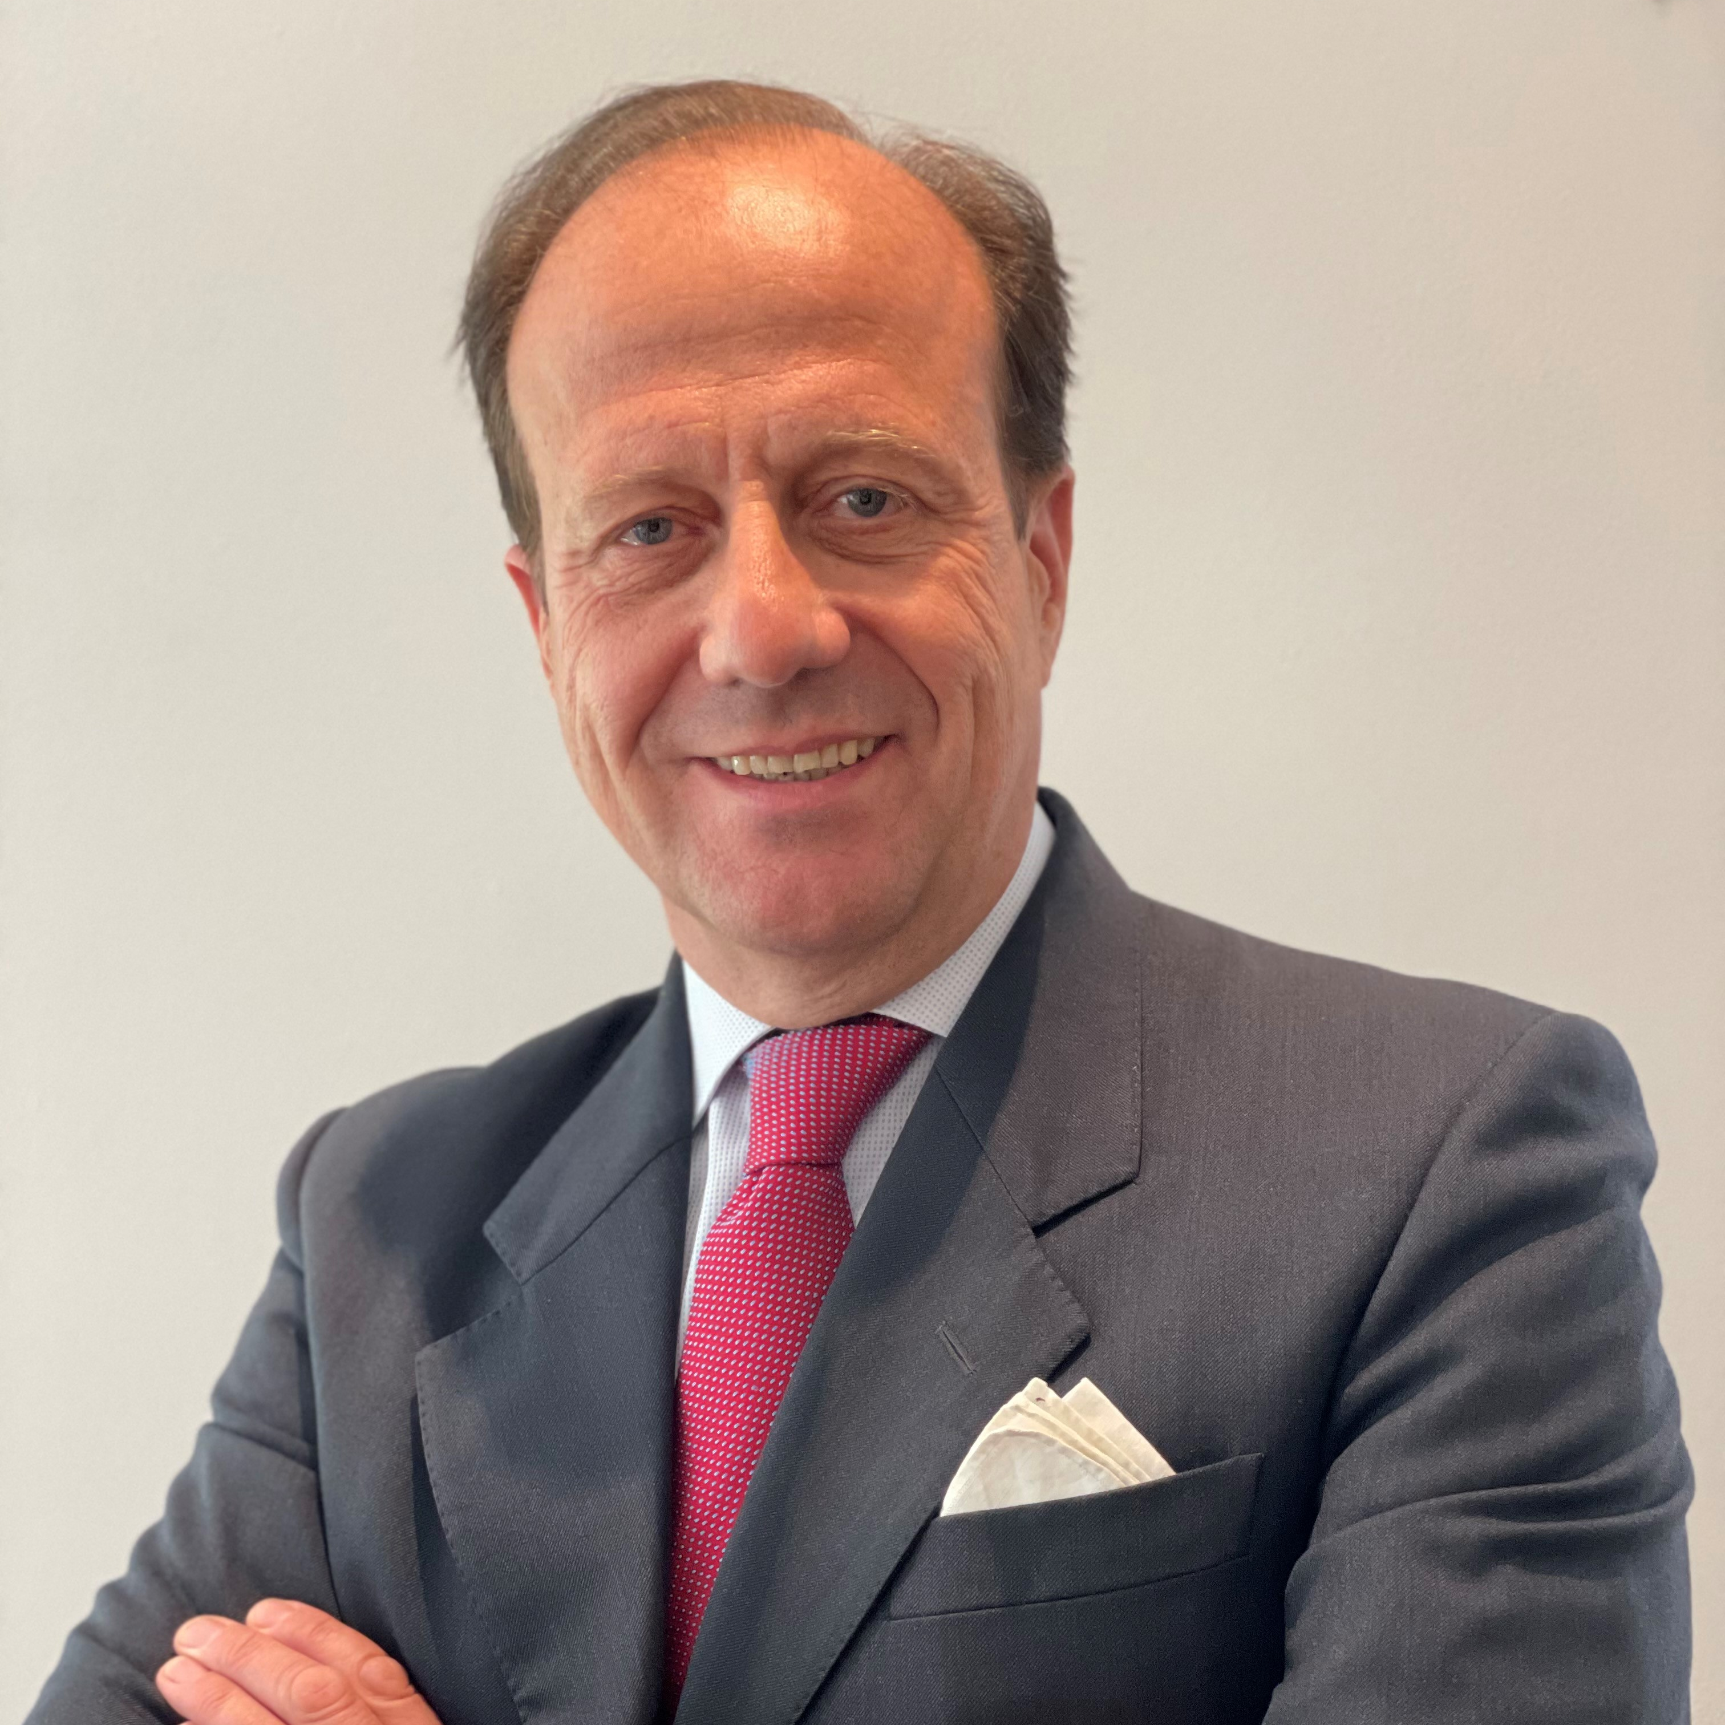
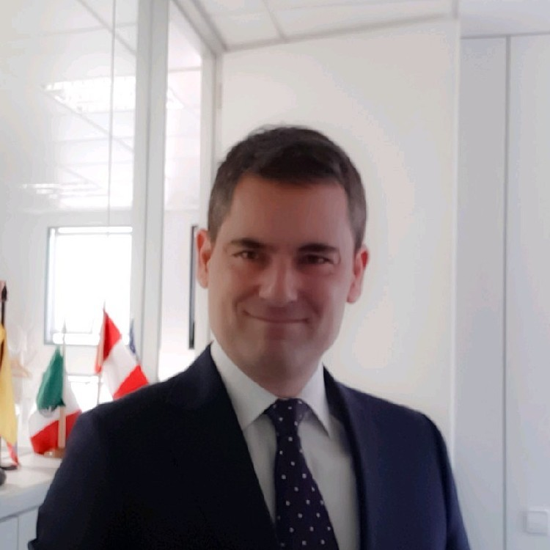
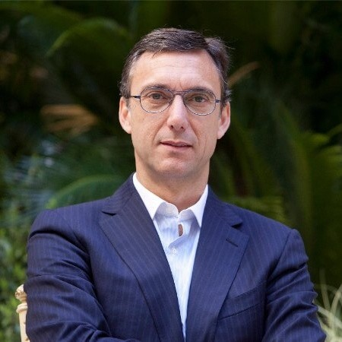
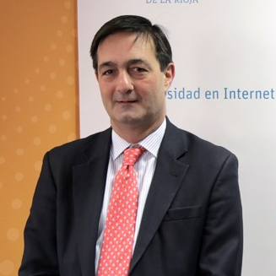

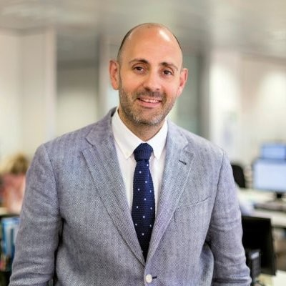

Highly experienced management team with proven roll-out track-record
6
Miguel Tomás Arrufat
Founder & CEO
  He is the founder and CEO of Grupo Proeduca since 2007, as well as the group's largest shareholder
  He has more than 25 years of experience in the field of education, having been CEO of the publishing house Magisterio Español. Additionally, he is a recognized patron in foundations such as Endeavor Spain and the Parentes Foundation
  Mr. Arrufat holds bachelors’ degree in Philosophy from the Universidad Autónoma de Barcelona and an MBA from IESE Business School
Rubén Stein
Executive Chairman
  He has been part of the Proeduca Group since 2013, having performed different functions such as Corporate Development. He is currently the Chairman of the Group's Board of Directors
  He has more than 25 years of experience in the financial sector, having been a partner of Inicia Corporate since its foundation. In addition, he has worked at The Chase Manhattan Bank, KPMG and Banco de España
  Mr. Stein holds a bachelors’ of Science in Business from CUNEF
Daniel Rubio
CFO
  More than 20 years of extensive experience in listed and unlisted companies, began his relationship with Grupo Proeduca in 2016 as Chief Financial Officer
  Previously, he worked at Morena Films, Secuoya Grupo, Onza Partners, Vértice 360, Atresmedia Group and Deloitte, among others
  Holds a dual bachelors’ in Law and Business Administration and Management from Universidad Pontificia de Comillas ICADE E-3
Carlos Gracia
Corporate Managing Director
  Mr. Gracia joined Proeduca in 2013 as Managing Director of Marketing and Business Development and is currently the Corporate Managing Director
  He has solid experience in strategic planning, innovation and marketing, among other functions. He has worked at Havas Sports & Entertainment and Havas Media Group, as well as at Mahou - San Miguel and Arbora & Ausonia
  Holds a bacherlors' of Law from the Universidad of Zaragoza, an MBA and PDD from IESE Business School and completed an Executive Marketing Program at IE Business School
Luis Usera
Business Managing Director
  He has been part of the Proeduca group since 2012 being Managing Business Director since his incorporation
  He had previously held executive positions in different teams of the Intereconomía Group, the last being as Managing Commercial Director. Additionally, he was linked to the education sector as Deputy Director of Secondary at the El Redín school (Pamplona, Spain)
  Holds a bachelors’ of Law from Universidad de Navarra and Executive Master (IE)
Pablo Pastor
Innovation Managing Director
  After a long and extensive professional career, he joined the Proeduca group in 2016 as Managing Director of Innovation
  For 30 years he developed his professional career in the IBM group, with special experience in the labour area, leading the Human Resources department for the IBM group in Spain, Portugal, Greece, Israel and Turkey. Additionally, he worked in the Management of Insituto Cuatrecasas HR Legal Strategy
  Hold a bachelors’ of Law from Universidad de Valencia
Rubén González
Vice-rector of Academic Planning and Faculty
  With more than 10 years in the Proeduca group, he is Professor in Computer Science and Artificial Intelligence and Vice-rector of Academic Organization and Faculty of UNIR and Global Academic Director of Proeduca
  He is an advisor and collaborator of the Ministry of Education (Spanish and Colombian) as well as a patron of the Fundación I + D del Software Libre. Previously, he was Director of Postgraduate Studies at the Universidad Pontificia de Salamanca, as well as Head of the Operating Systems Chair, among other positions
  Holds a degree in Computer Engineering, a masters' degree in Management and Project Management as well as a Masters' degree in Website Engineering and a PhD in Compute Engineering with honours
Maria Luisa Arjonilla
Technology Director (CIO)
  Director of Technology (CIO) at Proeduca since 2022
  Board Member at Unicaja Banco and she has been Managing Director in several public and multinational companies. She has held the position of Technology Director at Banco Santander, Banco Popular and Barclays Bank (Spain)
  Mrs. Arjonilla has been a professor at Universidad Carlos III, Universidad de Salamanca, Instituto de Estudios Bursátiles (IEB) and AFI Escuela de Finanzas
  Holds a degree of Biological Sciences (Universidad Complutense de Madrid), a Program of Managing Director (IESE) and a Master of Big-data & Business Analytics (UNED)

Slide 17
PROEDUCA: Multiple avenues for growth in the pipeline
1
Further consolidation of Proeduca’s operating portfolio and accredited offering
  Current offering (374 titles) still in ramp-up phase with ample room for commercialization and student base expansion
  Proeduca has launched more than 120 titles in the last 2 years demonstrating a solid innovation growth rate
2
Leverage existing content to further expand the addressable student base benefiting from economies of scale
  Flexible and “quasi-homogeneous” content able to serve other target segments and jurisdictions with limited cost effort
  Focus on targeting other Spanish speaking countries
3
Broadening of PROEDUCA’s current offering portfolio
  Proven lean, standardized and highly effective model to set up new bachelors’ degrees, get them accredited and launch them in multiple jurisdictions
  Ample room available to further expand Proeduca’s areas of knowledge within its current offering portfolio
4
Consolidation of PROEDUCA’s existing footprint and further expansion into other jurisdictions
  Sizeable and attractive market yet to be captured in its current footprint – imbalance between current offering and existing demand
  Well-suited to expand across new geographies leveraging current content
  Demonstrated ability to expand new online universities from scratch
5
Inorganic growth opportunities
  Pursue select ed add-on opportunities to potentially complement current offering, geographical presence, languages and target segments
  The online education is a highly fragmented market mainly composed of small and medium players, which could be suitable targets for Proeduca

